Slide 1

LNMHACKS 3.0
ZIRCON
-----Presents

Slide 2
What is it ?
It is a online platform to facilitate students a comfortable, personalized, efficient, affordable education in a click.
Best mentors guide them in their subjects from data filtering to evaluating them for their better experience.

Slide 3
Problems to look upon :
Students get tired off monotonous lectures available online.
There are abundance of irrelevant videos available online, which irritates students most.
There is no proper interaction between teachers and students during online lectures.
Purchase of any online study material ensures certification of desired subject, without proper throughput of that material.
No one-to-one interactions for doubt clearing sessions.

Slide 4
Our vision to its solution:
All the lectures will be cross-checked by the panel of mentors before being uploaded at our website, which ensures the quality of videos on our site.
More than one lecture on a topic will not be entertained.
Brain storming tests will be organized frequently for students to enhance their knowledge about the subject.
A final test will be conducted to ensure that the student is well versed with the subject.
Students can personalize lectures according to their interest and comfort .
Every student will be assigned a personal lecturer for a day or so for their doubt solving sessions.
Students will be kept updated with the latest trending topics according to their interests in our news feed column.

Slide 5

All the lectures will be cross-checked by the panel of mentors before being uploaded at our website, which ensures the quality of videos on our site.

Slide 6

More than one lecture on a topic will not be entertained.

Slide 7
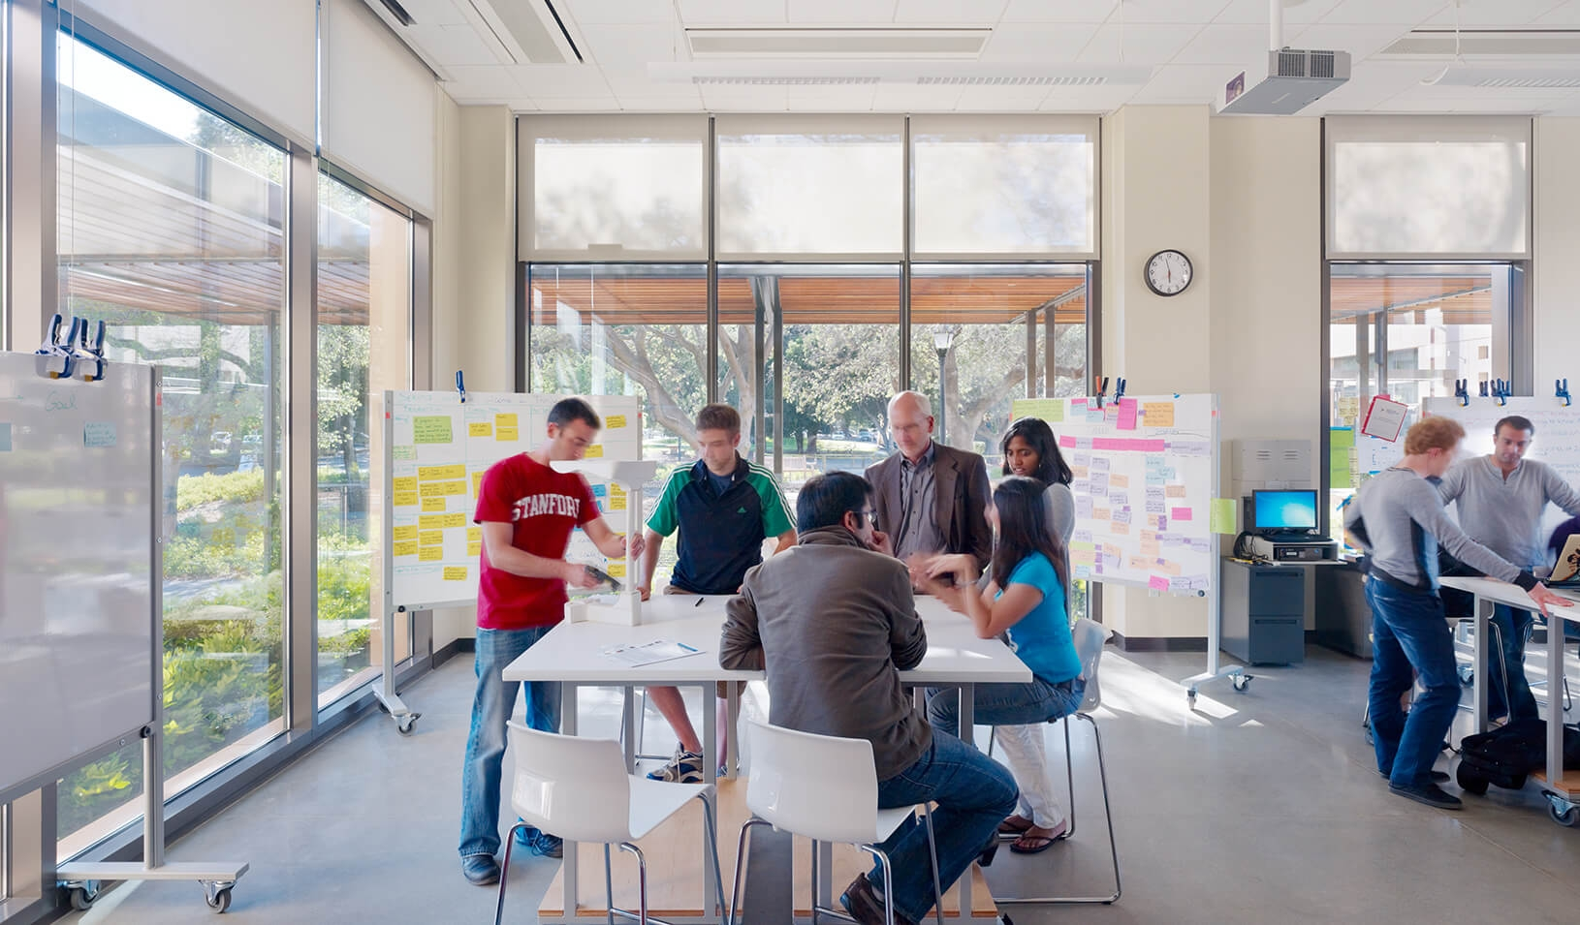
Brain storming tests will be organized frequently for students to enhance their knowledge about the subject.

Slide 8

A final test will be conducted to ensure that the student is well versed with the subject.

Slide 9

Students can personalize lectures according to their interest and comfort .

Slide 10

Every student will be assigned a personal lecturer for a day or so for their doubt solving sessions.

Slide 11

Students will be kept updated with the latest trending topics according to their interests in our news feed column.

Slide 12
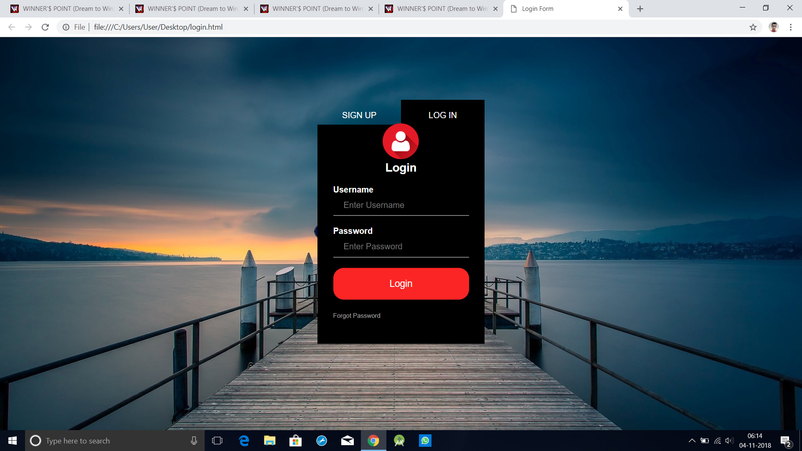
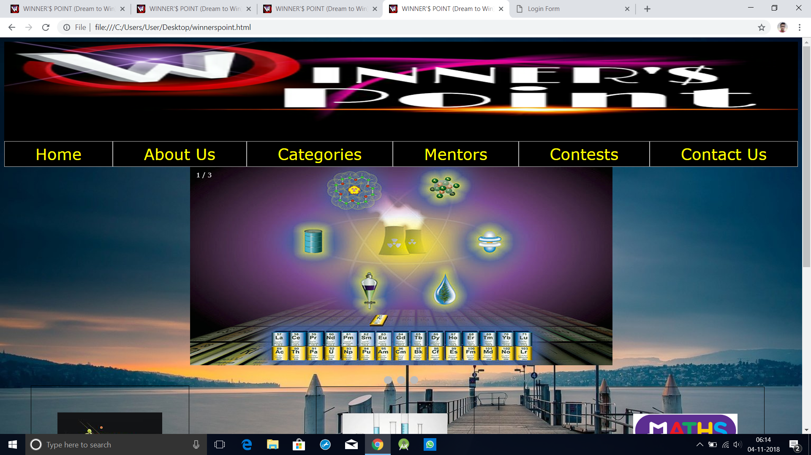
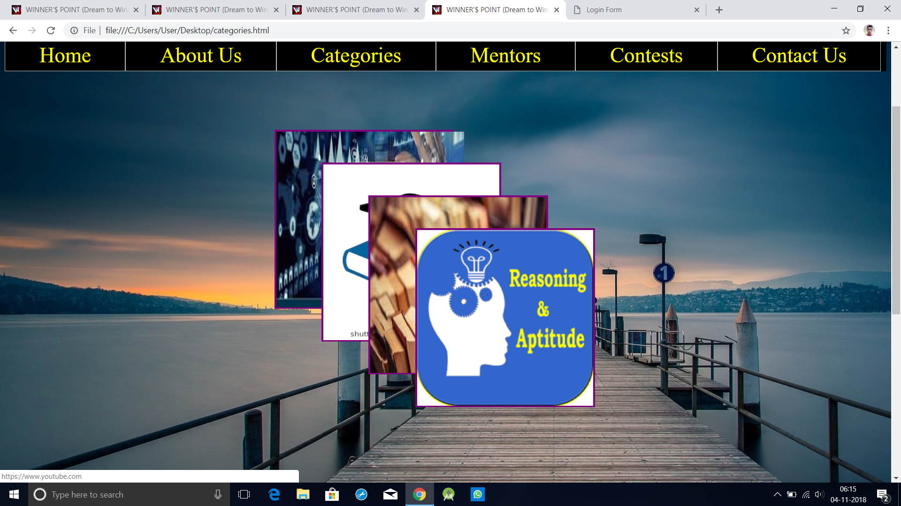
Glimpse of our web page :

Slide 13
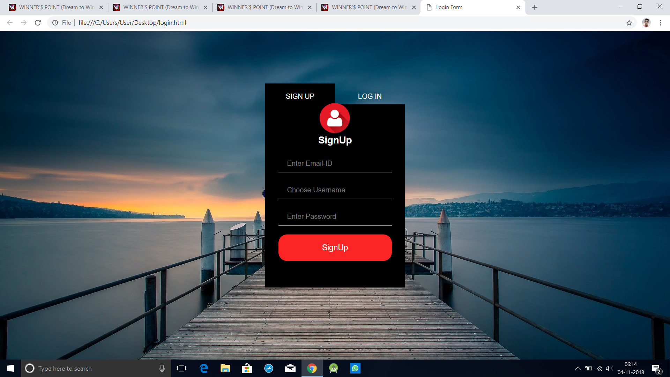
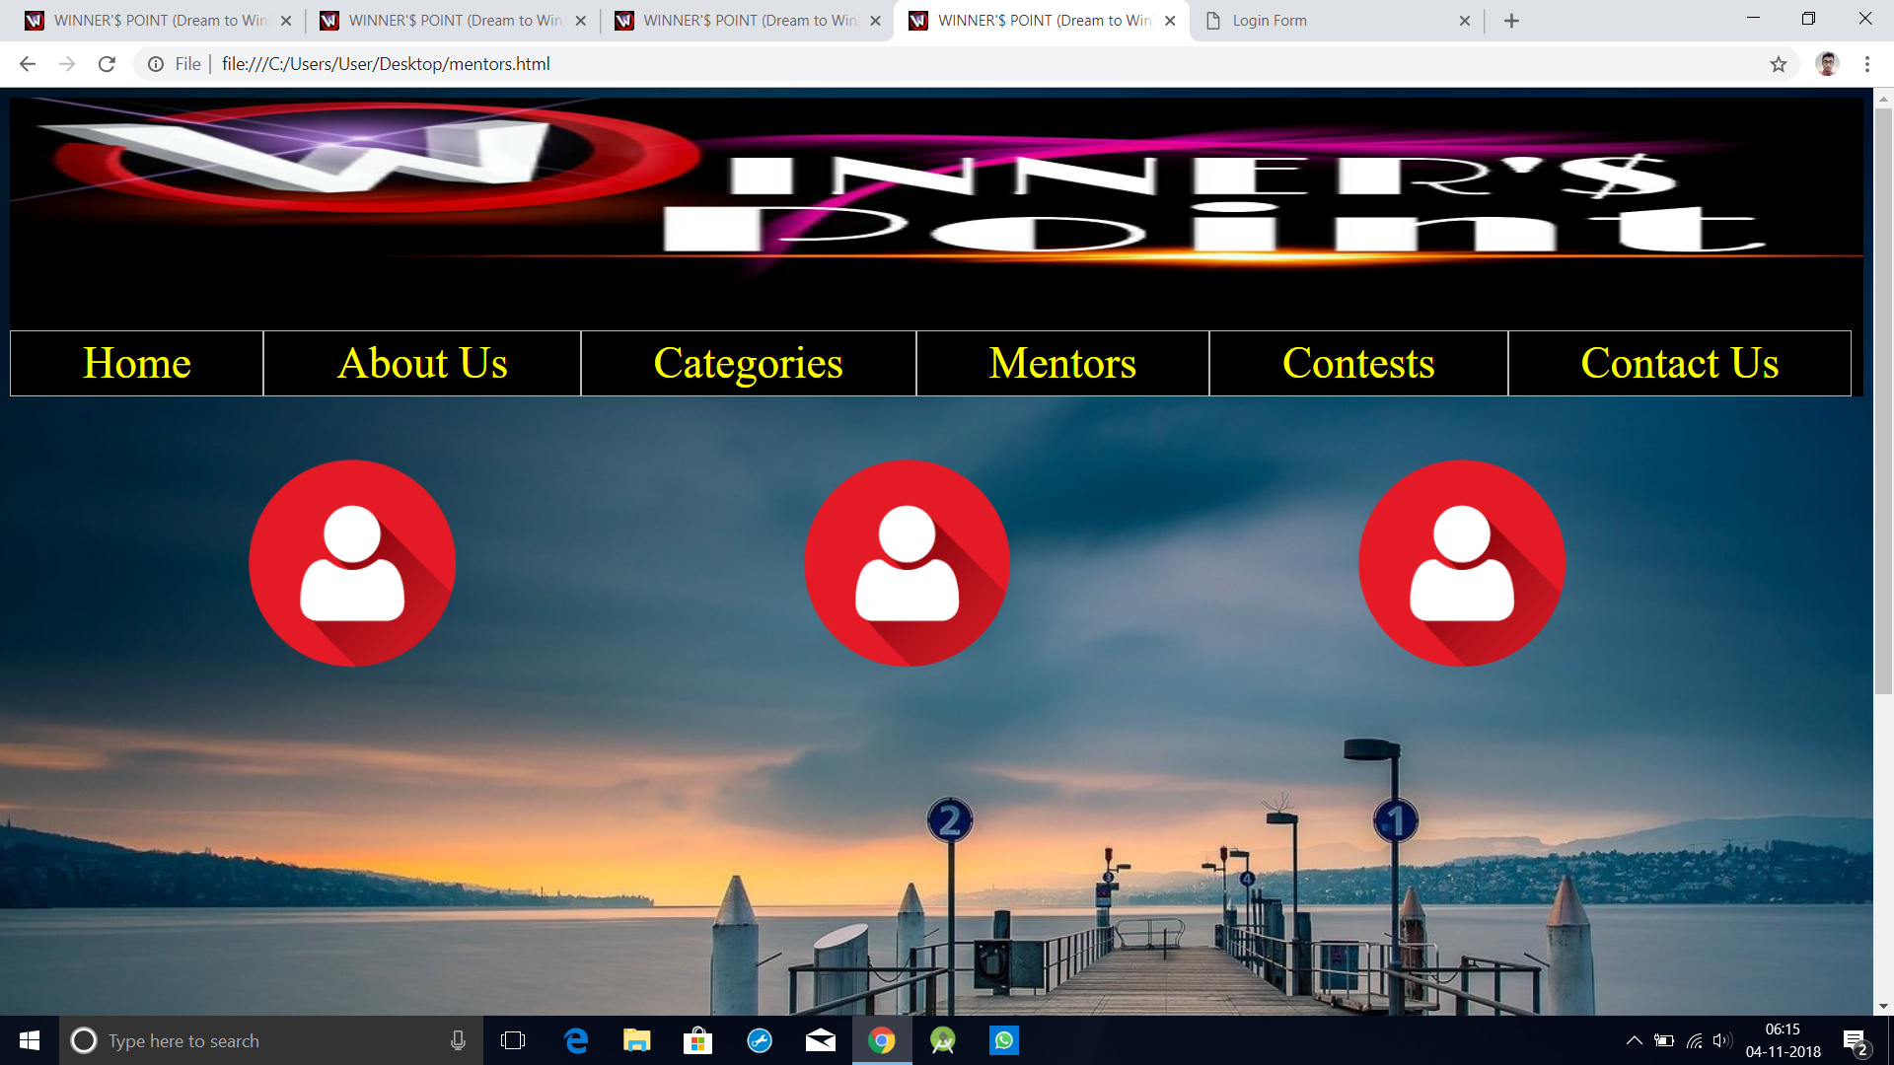
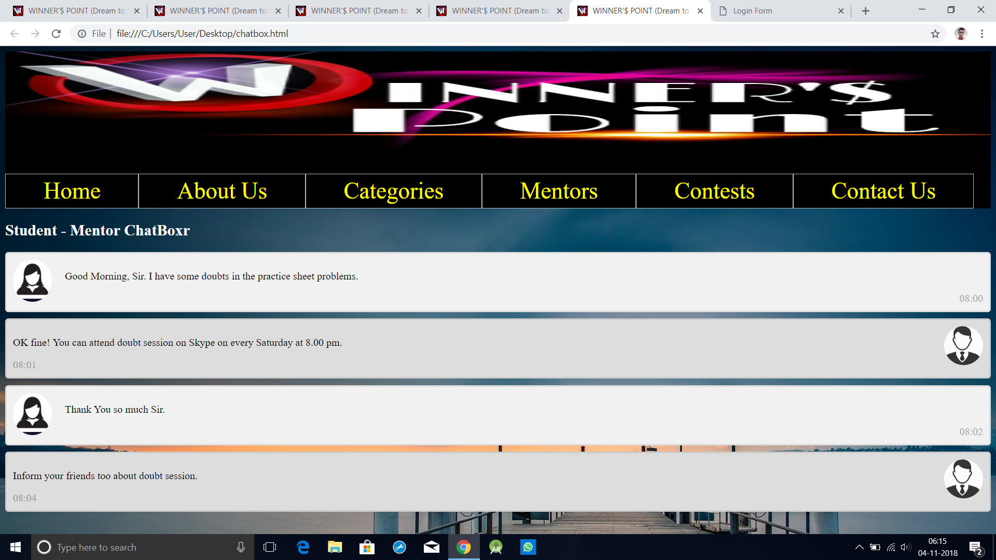
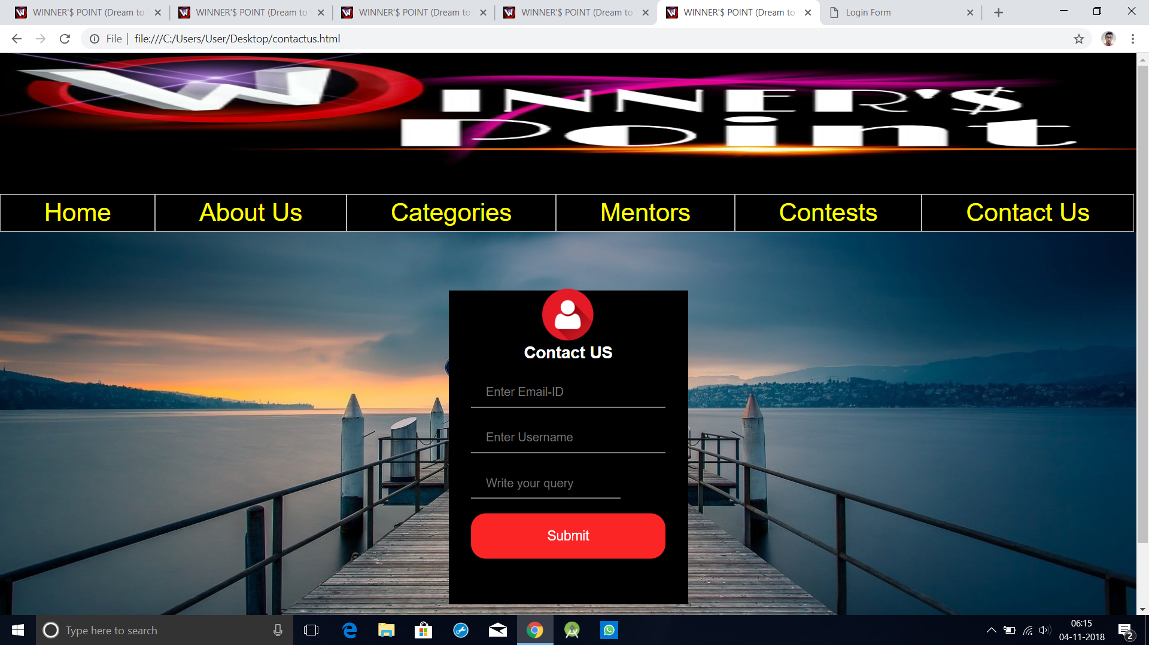

Slide 14
Idea Represented By (CS-II , B.Tech, III Year) :-
Karan Ludhani – ludhani.karan806@gmail.com
Soumya Awasthi – soumya.awasthi08@gmail.com
Sarika Singh – sarikasingh.ssm@gmail.com

